Slide 1

War Card Game Application
By: Aaron Hossain, Ehsan Hussain, Arend Markies

Slide 2
Rules
Each player is given half of a full card deck. (27 cards)
They must draw a card and the value must be higher than that of their opponent's.
If the values match, a WAR is initiated where each player draws 3 face down cards and battle one more time. Winner takes everything!
Jokers beat everything

Slide 3
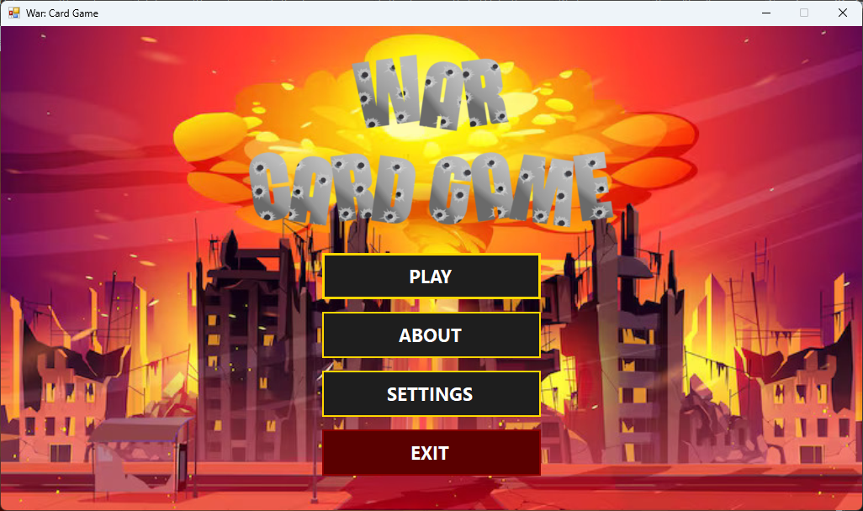
Main Menu
Play: Simply prompts user to a Play option game form where player chooses to play against a bot or player.
About: Shows information about the game and developers.
Settings: Change player names, toggle music on/off and switch languages (English,French and Spanish)
Exit: Closes app

Slide 4
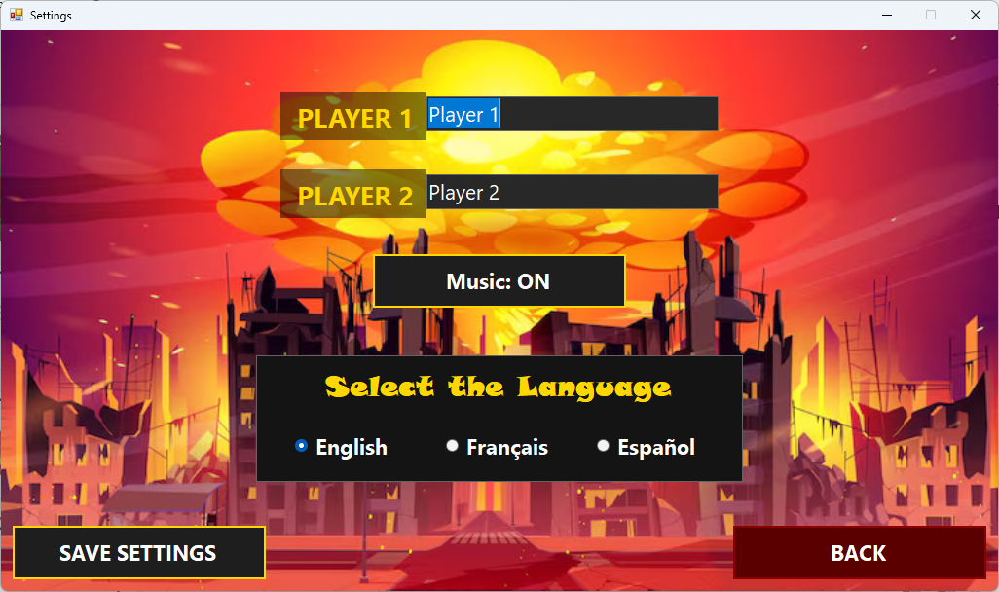
Settings page

Slide 5
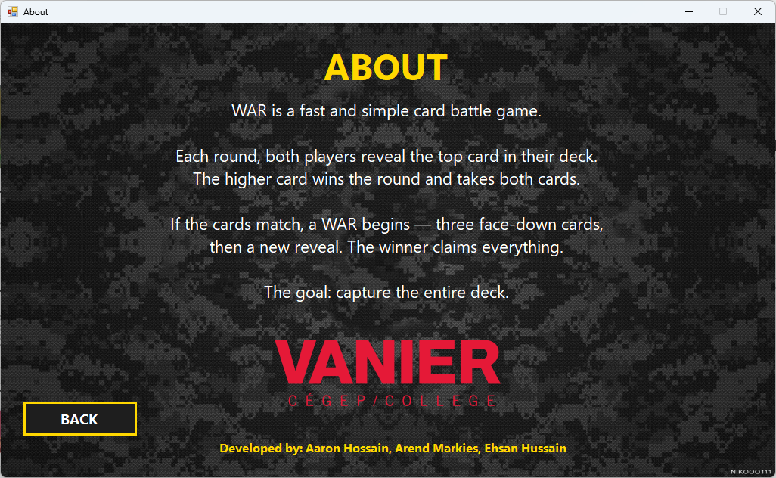
Info page

Slide 6
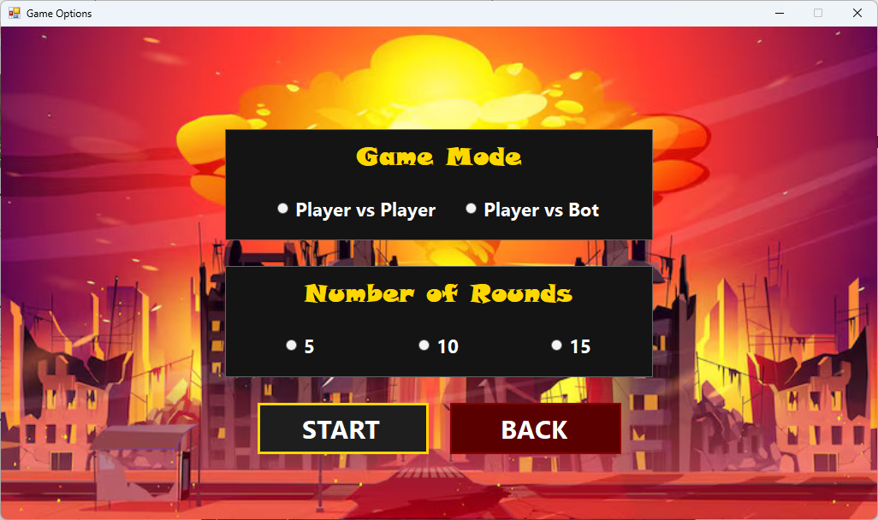
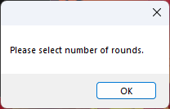
Play option menu
We included validation so user always chooses a game mode AND number of rounds, otherwise user gets a prompt.

Slide 7
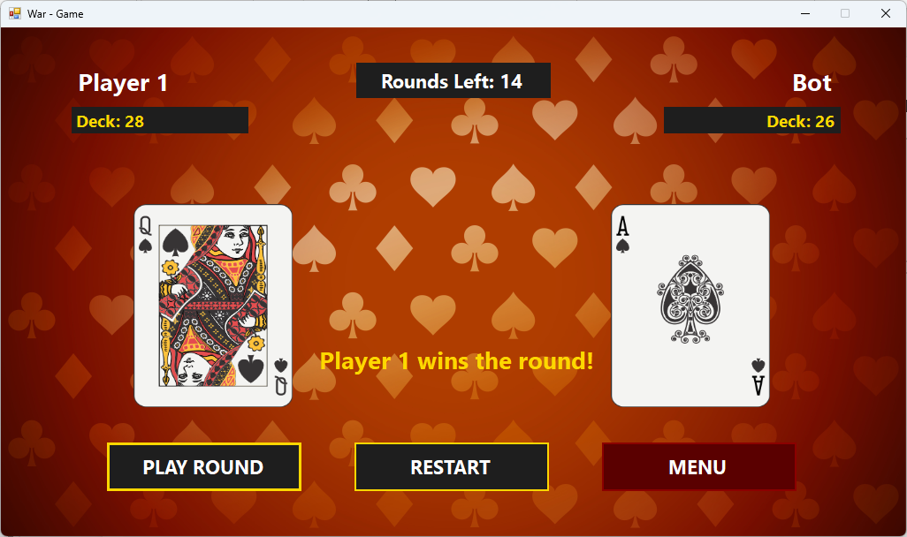
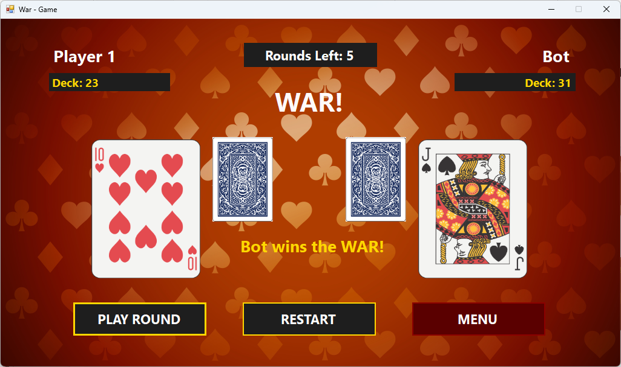
Game form

Slide 8
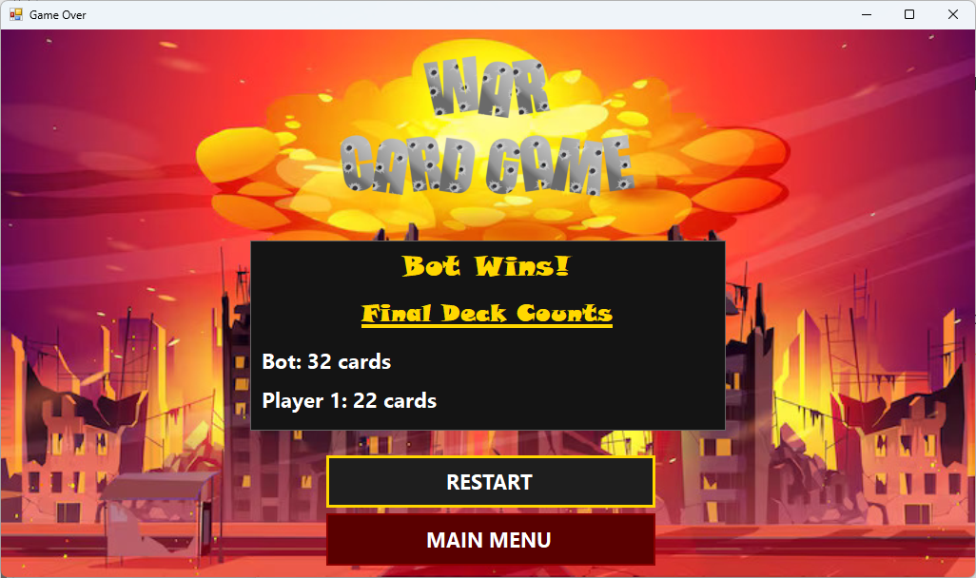
End form

Slide 9
Challenges
Working on managing music throughout the app and playing the right audio in the right form. Also transitioning between forms like main menu to settings.
Implementing game logic and mapping each card object to an image. Also card flip animation was very challenging.
Localization
Player names in Settings page and making sure it saves for when a game is started.
Closing the application (in another form other than menu)

